Slide 1
Port

Slide 2
a seaport, literally a port at or on the sea. Everyone wanting to dock there—requesting landing services—uses the same port.
Seaports work with berth numbers assigned to individual boats. The port name and the berth number combine into the "who, what, and where" of boat identification.
user's numerical identifier on the Internet. Depending on connection type and service provider, a user's IP address may or may not remain the same with each connection to or "docking" on the Internet.
A computer port is a type of electronic, software- or programming-related docking point through which information flows from a program on your computer or to your computer from the Internet or another computer in a network.
In computer terms, a computer or a program connects to somewhere or something else on the Internet via a port. Port numbers and the user's IP address combine into the "who does what" information kept by every Internet Service Provider.

Slide 3
Ports are numbered for consistency and programming. The most commonly used and best known ports are those numbered 0 to 1023 dedicated for Internet use, but they can extend far higher for specialized purposes. Each port set or range is assigned specialized jobs or functions, and that's generally all they do. Usually, all identical system services or functions use the same port numbers on the receiving servers.
For example, all computers accessing or requesting Quote of the Day will always use port 17, because that port is officially reserved for that purpose, and only requests for that service use port 17. Outgoing information is channeled through a different or private port, keeping the "incoming line" open for others. Email received on a local computer generally uses a TCP port 25. File Transport Protocol or FTP uses port 21, to name only a few port assignments.

Slide 4
Port Range
0 to 1023 - Well known port numbers. Only special companies like Apple QuickTime, MSN, SQL Services, Gopher Services and other prominent services have these port numbers.
1024 to 49151 - Registered ports; meaning they can be registered to specific protocols by software corporations.
49152 to 65536 - Dynamic or private ports; meaning that they can be used by just about anybody.

Slide 5
Port Scanning
Port Scanning is the name for the technique used to identify open ports and services available on a network host.
It is sometimes utilized by security technicians to audit computers for vulnerabilities, however, it is also used by hackers to target victims.
It can be used to send requests to connect to the targeted computers, and then keep track of the ports which appear to be opened, or those that respond to the request.
When a criminal targets a typically the first thing they checks is if there is an open window or door through which access to the home can be gained.
A Port scan is similar, only the windows and doors are the ports of the individual's personal computer.
While a hacker may not decide to "break in" at that moment, he or she will have determined if easy access is available.

Slide 6
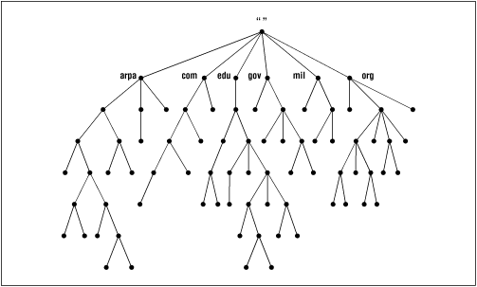

Slide 7
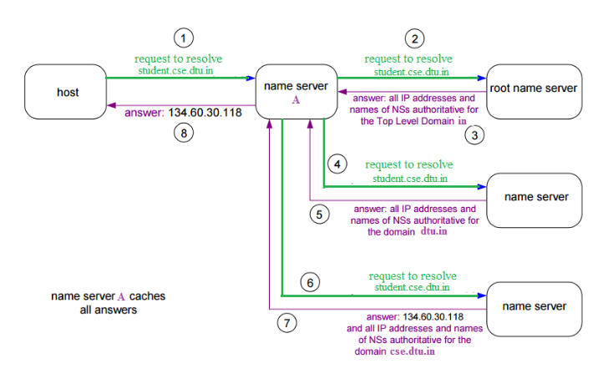
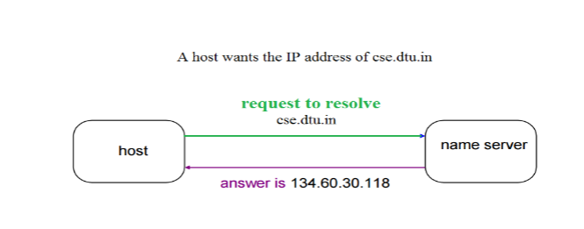

Slide 8
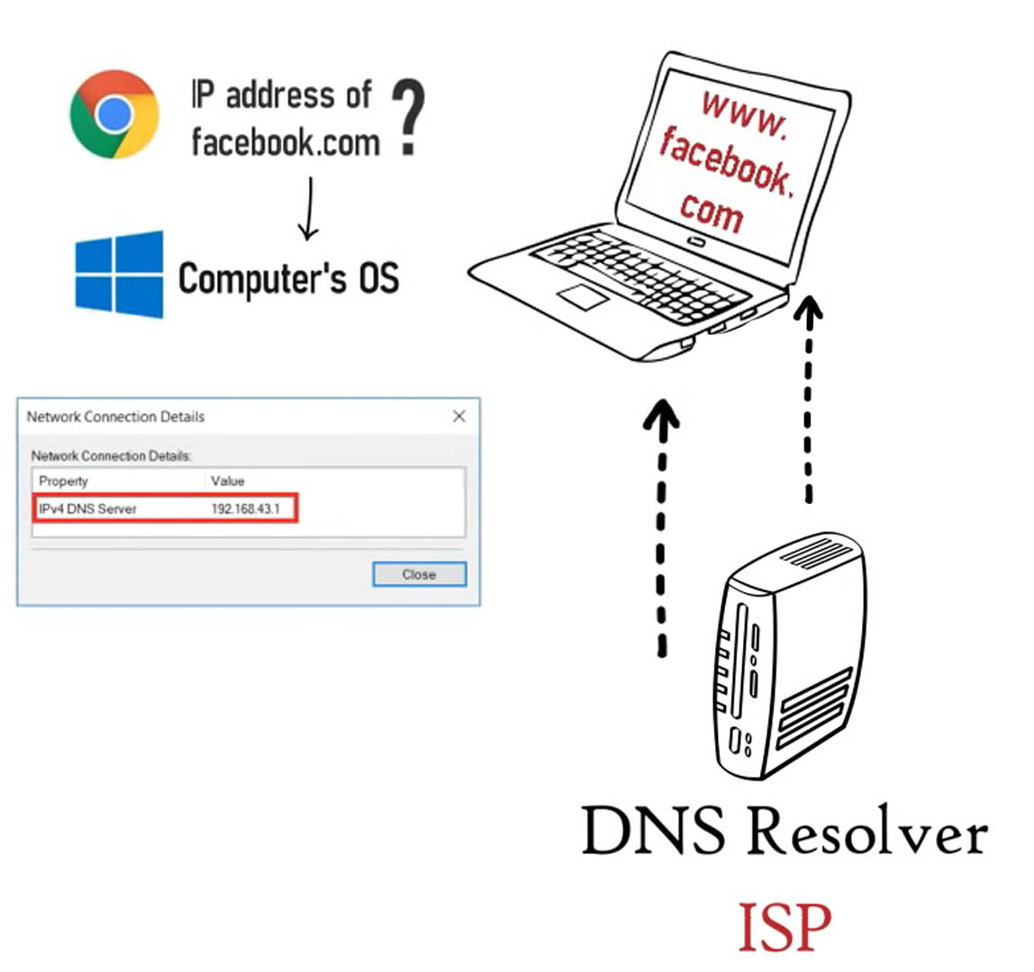

Slide 9
